Slide 1
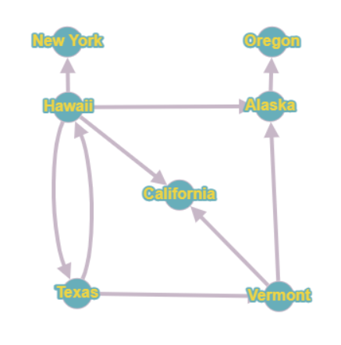
CMSC204
Kartchner
V(StateGraph) = {Oregon, Alaska, Texas, Hawaii, Vermont, NewYork, California}
E(StateGraph) = {(Alaska, Oregon), (Hawaii, Alaska), (Hawaii, Texas), (Texas, Hawaii), (Hawaii, California), (Hawaii, New York), (Texas, Vermont), (Vermont, California), (Vermont, Alaska)}
1. Draw the StateGraph

Slide 2
a. Show the adjacency matrix that would describe the edges in the graph. Store the vertices in alphabetical order
States
Alaska California Hawaii New York Oregon Texas Vermont
Alaska
California
Hawaii
New York
Oregon
Texas
Vermont
0 0 0 0 1 0 0
0 0 0 0 0 0 0
1 1 0 1 0 1 0
0 0 0 0 0 0 0
0 0 0 0 0 0 0
0 0 1 0 0 0 1
1 1 0 0 0 0 0
3. b. Show the adjacency lists
that would describe the edges in the graph
Alaska
California
Hawaii
New York
Oregon
Texas
Vermont
Oregon
Alaska, California, New York, Texas
Hawaii, Vermont
Alaska, California

Slide 3
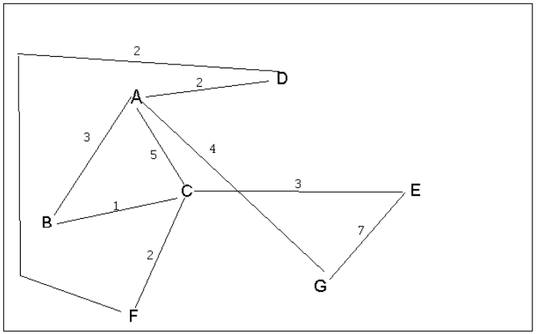
4 a. Which of the following lists the graph nodes in depth first order beginning with E?
A) E, G, F, C, D, B, A (No, F comes too early)
B) G, A, E, C, B, F, D (No, does not start at E)
C) E, G, A, D, F, C, B
D) E, C, F, B, A, D, G (No, B comes too early)
4 b. Which of the following lists the graph nodes in breadth first order beginning at F?
A) F, C, D, A, B, E, G
B) F, D, C, A, B, C, G (No, repeats C and misses E)
C) F, C, D, B, G, A, E (No, G comes too early)
D) a, b, and c are all breadth first traversals

Slide 4
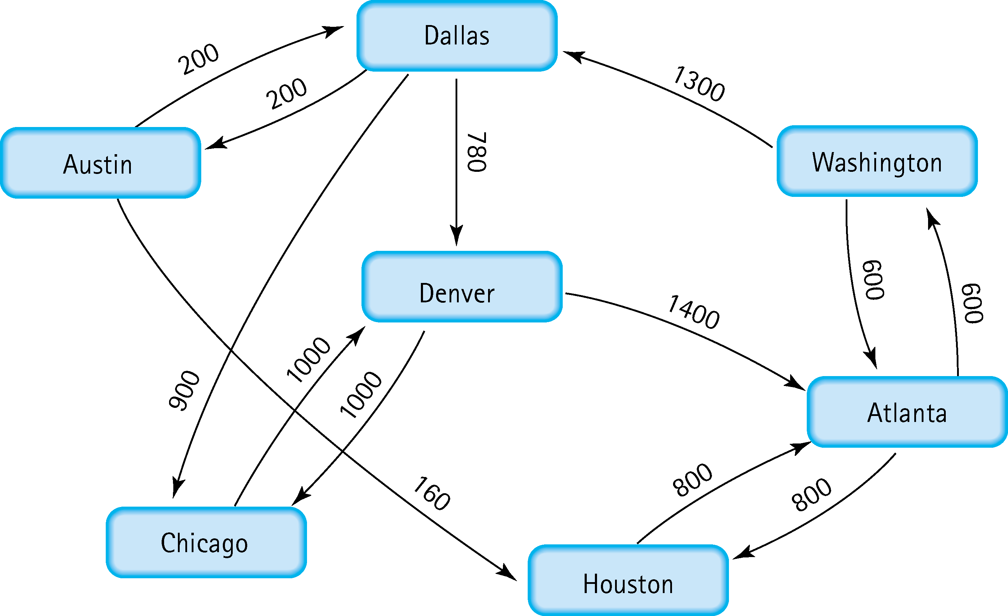
5. Find the shortest distance from Atlanta to every other city
Atlanta -> Washington: 600
Atlanta -> Houston: 800
Atlanta -> Dallas: 1900
Atlanta -> Austin: 2100
Atlanta -> Denver: 2680
Atlanta -> Chicago: 2800

Slide 5
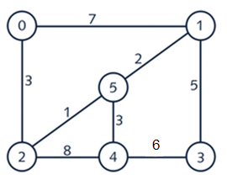


6. Find the minimal spanning tree using Prim’s algorithm. Use
0 as the source vertex . Show the steps.
Start at Node 0;
Paths 0-1 and 0-2 available, 0-2 cheapest;
Paths 0-1, 2-5, and 2-4 available, 2-5 cheapest;
Paths 0-1, 2-4, 5-1, and 5-4 available, 5-1 cheapest;
Paths 1-3, 2-4, and 5-4 available, 5-4 cheapest;
Paths 1-3 and 4-3, 1-3 cheapest;
Minimal Spanning Tree: {{0,2},{2,5},{5,1},{5,4},{1,3}}

Slide 6


7. Find the minimal spanning tree using Kruskal’s algorithm.
Show the weights in order and the steps.
Weight Pair
1
2
3
3
5
6
7
8
(2,5) (1,5)
(0,2)
(4,5)
(1,3)
(3,4)
(0,1)
(2,4)
Edge 2-5 cheapest; no cycle
Edge 1-5 cheapest; no cycle
Edge 0-2 cheapest; no cycle
Edge 4-5 cheapest; no cycle
Edge 1-3 cheapest; no cycle
Edges = Nodes-1; Completed
Minimal Spanning Tree: {{0,2},{2,5},{5,1},{5,4},{1,3}}

Slide 7
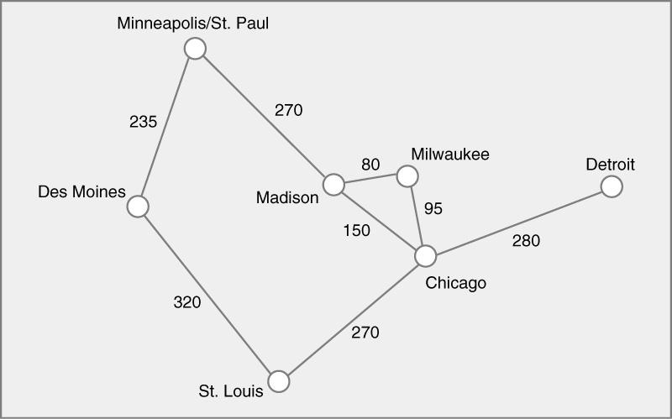




8. Find the minimal spanning tree using the algorithm you prefer. Use
Minneapolis/St. Paul as the source vertex
Prim’s Algorithm:
Start at SP;
Paths SP-Ma and SP-DM available, SP-DM cheapest;
Paths DM-SL and SP-Ma available, SP-Ma cheapest;
Paths DM-SL, Ma-Mi, and Ma-Ch available, Ma-Mi cheapest;
Paths DM-SL, Ma-Ch, and Mi-Ch available, Mi-Ch cheapest;
Paths DM-SL, Ch-SL, and Ch-De available, Ch-SL cheapest;
Paths Ch-De available, Ch-De cheapest;
Minimal Spanning Tree: {{SP,DM},{SP,Ma},{Ma,Mi},{Mi,Ch},{Ch,SL},{Ch,De}}

Slide 8
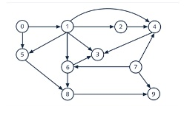
9. List the nodes of the graph in a breadth first topological ordering. Show the
steps using arrays predCount, topologicalOrder and a queue
predCount: [0, 1, 1, 3, 3, 2, 2, 0, 2, 2]
topologicalOrder: []
queue: 0, 7
predCount: [0, 0, 1, 3, 3, 1, 2, 0, 2, 2]
topologicalOrder: [0]
queue: 7, 1
predCount: [0, 0, 1, 3, 2, 1, 1, 0, 2, 1]
topologicalOrder: [0, 7]
queue: 1
predCount: [0, 0, 0, 2, 1, 0, 0, 0, 2, 1]
topologicalOrder: [0, 7, 1]
queue: 2, 5, 6
predCount: [0, 0, 0, 2, 0, 0, 0, 0, 2, 1]
topologicalOrder: [0, 7, 1, 2]
queue: 5, 6, 4

Slide 9
9. List the nodes of the graph in a breadth first topological ordering. Show the
steps using arrays predCount, topologicalOrder and a queue
predCount: [0, 0, 0, 2, 0, 0, 0, 0, 1, 1]
topologicalOrder: [0, 7, 1, 2, 5]
queue: 6, 4
predCount: [0, 0, 0, 1, 0, 0, 0, 0, 0, 1]
topologicalOrder: [0, 7, 1, 2, 5, 6]
queue: 4, 8
predCount: [0, 0, 0, 0, 0, 0, 0, 0, 0, 1]
topologicalOrder: [0, 7, 1, 2, 5, 6, 4]
queue: 8, 3
predCount: [0, 0, 0, 0, 0, 0, 0, 0, 0, 0]
topologicalOrder: [0, 7, 1, 2, 5, 6, 4, 8]
queue: 3, 9
predCount: [0, 0, 0, 0, 0, 0, 0, 0, 0, 0]
topologicalOrder: [0, 7, 1, 2, 5, 6, 4, 8, 3, 9]
queue:

Slide 10
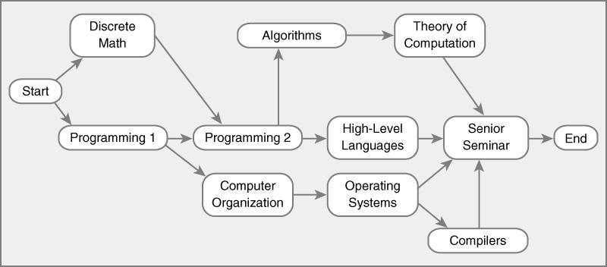
10. List the nodes of the graph in a breadth first topological ordering.
Start; Discrete Math and Programming 1 enqueued
Discrete Math; Programming 1 enqueued
Programming 1; Programming 2 and Computer Organization enqueued
Programming 2; Computer Organization, Algorithms, and High-Level Languages Enqueued
Computer Organization; Algorithms, High-Level Languages, and Operating Systems enqueued
Algorithms; High-Level Languages, Operating Systems, and Theory of Computation enqueued
High-Level Languages; Operating Systems and Theory of Computation enqueued
Operating Systems; Theory of Computation and Compilers enqueued
Theory of Computation; Compilers enqueued
Compilers; Senior Seminar enqueued
Senior Seminar; End enqueued
End;

